Slide 1
Hawke Meditation Centre
Release 2
Team Hawke 86

Slide 2
Release 2
Student Usability
Class Selection Upon Enrolment
User Page Functionality
Unit Tests
Server Tasks
Server’s Access to Dietary Requirements
Manager Tasks
Managers Can Ban Users
Manager can Cancel Scheduled Courses
Course Commencement Notification

Slide 3
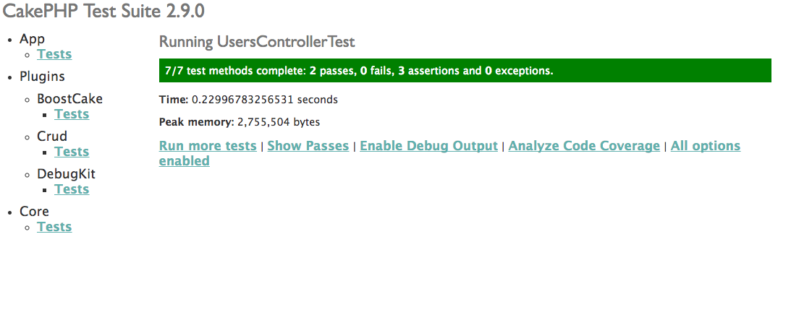
Unit tests

Slide 4
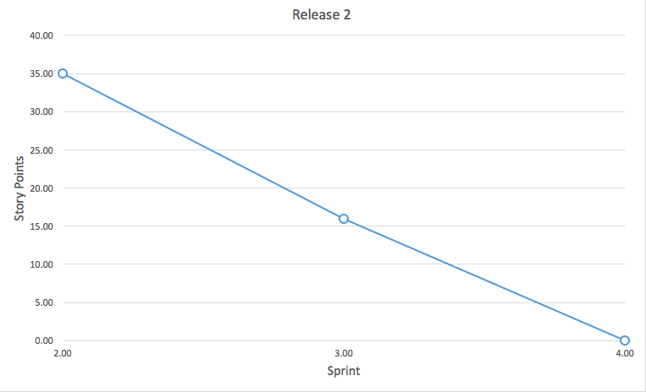
Burndown Chart - Release 2

Slide 5
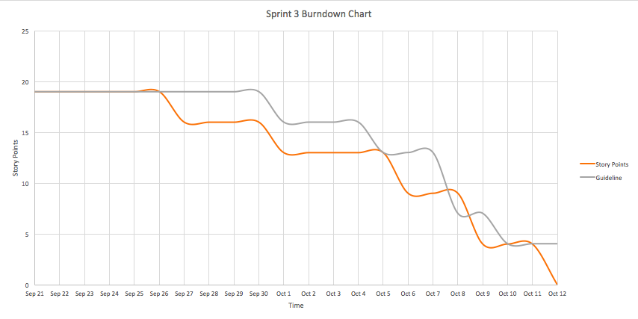
Burndown Chart - Sprint 3

Slide 6
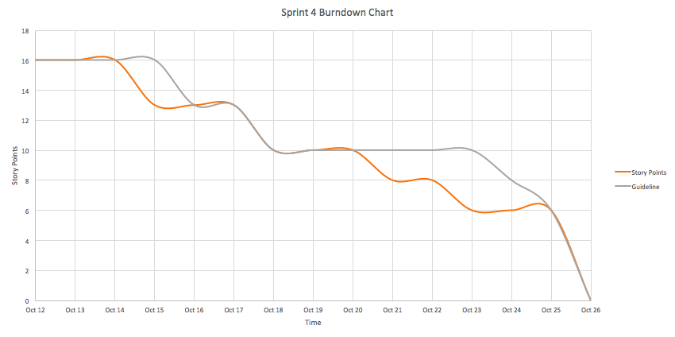
Burndown Chart - Sprint 4

Slide 7
Release 3
Calendar Integration

